Slide 1
Gender Equity in Academia
Liam Gibson, August, 2023

Slide 2

Introduction
Who am I?
Why am I here?
Applied mathematician (citation needed)
Applied mathematics textbook
Figure 1: PhD student hard at work

Slide 3
Table of Contents
Gender disparities in society
Gender disparities in academia
Mathematical models
Final note

Slide 4
1. Gender disparities in society
Representation gaps (Havard’s ‘Gender Action Portal’)
Female CEOs in Fortune 500 companies ~0% in 1995 (~24% in 2015)
Women’s representation on boards in Europe ~11% in 2007 (23% in 2016)
Getting better, but...

Slide 5
1. Gender disparities in society
Pay gaps
National gender pay gap ~9.1%
Unchanged since early 2010s (Stats NZ, 2019)
Function of age
<25 years old: ~0%
25<55: ~20%
>55: ~50%
Causes
Differences in education
Choice of occupation
Differences in contract (part-time vs. full-time)
...

Slide 6
1. Gender disparities in society
Pay gaps
National gender pay gap ~9.1%
Unchanged since early 2010s (Stats NZ, 2019)
Function of age
<25 years old: ~0%
25<55: ~20%
>55: ~50%
Causes
Differences in education
Choice of occupation
Differences in contract (part-time vs. full-time)
Discrimination

Slide 7
1. Gender disparities in society
Pay gaps
Women have the same projected sense of belonging, positivity towards, and aspirations to participate in STEM as men do
Women are as productive and bargin for promotion as much as men do
Women undergraduates receive, on average, one grade higher than comparable men do

Slide 8
1. Gender disparities in society
Authority gaps
Men report women ‘dominating’ conversation when they talk 30% of the time (Spender, 1980)
In cross-sex two-party conversations, 96% of the interruptions and 100% of overlapping-speech comes from men (Zimmerman, West, 1975)
US Supreme Court transcripts show women are 4 times more likely to be interrupted than their male colleagues; 96% of interrupts were by male advocates or justices (Jacobi, Schweers, 2017)

Slide 9
2. Gender disparities in academia
Historical context (Else, 2018)
Educating women was seen as pointless – higher education ‘unfitted’ women for marriage and motherhood
Women have been absent from higher education; in some subjects as recently as the 1990s.
E.G., medicine, law, and mathematics were seen as ‘too taxing’ – Greek was seen as ‘crass’ because it taught of homosexuality :O
Pay gaps
University of Canterbury ~$400,000 lifetime gender gap (Brower, James, 2020)
Standardised pay scale => pay gaps are (kinda) representation gaps
Representation gaps
At UC, about 560 academic staff per year, on average 36% women
About 100 professors, on average 18% women – although, 27% now

Slide 10
2. Gender disparities in academia
Individual biases
Moss-Racusin et al. (2012) – randomized double-blind study (n = 127)
Applicants for science faculty position identical apart from gender

Slide 11
2. Gender disparities in academia
Individual biases
Moss-Racusin et al. (2012) – randomized double-blind study (n = 127)
Applicants for science faculty position identical apart from gender
Male applicants rated more competent and hireable – offered higher starting salaries and more mentoring

Slide 12
2. Gender disparities in academia
Individual biases
Moss-Racusin et al. (2012) – randomized double-blind study (n = 127)
Applicants for science faculty position identical apart from gender
Male applicants rated more competent and hireable – offered higher starting salaries and more mentoring
Draw-backs: small sample size; old-ish; single study; external validity

Slide 13
2. Gender disparities in academia
Individual biases
Moss-Racusin et al. (2012) – randomized double-blind study (n = 127)
Applicants for science faculty position identical apart from gender
Male applicants rated more competent and hireable – offered higher starting salaries and more mentoring
Draw-backs: small sample size; old-ish; single study; external validity
Begeny et al. (2020) – randomized double-blind study (n = 237)
Managers evaluated identical vetinarians called Mark or Elizabeth

Slide 14
2. Gender disparities in academia
Individual biases
Moss-Racusin et al. (2012) – randomized double-blind study (n = 127)
Applicants for science faculty position identical apart from gender
Male applicants rated more competent and hireable – offered higher starting salaries and more mentoring
Draw-backs: small sample size; old-ish; single study; external validity
Begeny et al. (2020) – randomized double-blind study (n = 237)
Managers evaluated identical vetinarians called Mark or Elizabeth
Mark was evaluated as more competent and offered $5,427 more per year (~8% pay gap)
Managers who thought gender bias was not happening were the key drivers of it

Slide 15
2. Gender disparities in academia
Systemic biases
Expectations for women to be exceptional, because they’re underrepresented, i.e., the exception!
SETs fail to account for higher expectations on women lecturers (Adams et al., 2021)
Women with moderate research output recognised less than men (James, Brower, 2022)
Gender neutral parental leave fails to account for higher childrearing expectations for women (Antecol, Bedard, Stearns, 2018)
Higher internal standards; anticipate harsher treatment of research; incentives for maximising research output => productivity gap in academia (Bright, 2016)

Slide 16
2. Gender disparities in academia
Systemic biases
Expectations for women to be exceptional, because they’re underrepresented, i.e., the exception!
SETs fail to account for higher expectations on women lecturers (Adams et al., 2021)
Women with moderate research output recognised less than men (James, Brower, 2022)
Gender neutral parental leave fails to account for higher childrearing expectations for women (Antecol, Bedard, Stearns, 2018)
Higher internal standards; anticipate harsher treatment of research; incentives for maximising research output => productivity gap in academia (Bright, 2016)
NSF data suggests greater attrition rate in STEM (Hunt, 2016)
50% of gap explained by women dissatisfied with pay and promotion opportunities

Slide 17
2. Gender disparities in academia
Systemic biases
Expectations for women to be exceptional, because they’re underrepresented, i.e., the exception!
SETs fail to account for higher expectations on women lecturers (Adams et al., 2021)
Women with moderate research output recognised less than men (James, Brower, 2022)
Gender neutral parental leave fails to account for higher childrearing expectations for women (Antecol, Bedard, Stearns, 2018)
Higher internal standards; anticipate harsher treatment of research; incentives for maximising research output => productivity gap in academia (Bright, 2016)
NSF data suggests greater attrition rate in STEM (Hunt, 2016)
50% of gap explained by women dissatisfied with pay and promotion opportunities
What can we do? Publish research?

Slide 18
2. Gender disparities in academia
Systemic biases
Expectations for women to be exceptional, because they’re underrepresented, i.e., the exception!
SETs fail to account for higher expectations on women lecturers (Adams et al., 2021)
Women with moderate research output recognised less than men (James, Brower, 2022)
Gender neutral parental leave fails to account for higher childrearing expectations for women (Antecol, Bedard, Stearns, 2018)
Higher internal standards; anticipate harsher treatment of research; incentives for maximising research output => productivity gap in academia (Bright, 2016)
NSF data suggests greater attrition rate in STEM (Hunt, 2016)
50% of gap explained by women dissatisfied with pay and promotion opportunities
Bonus Individual Bias: STEM academics evaluate identical abstracts as lower quality when they report gender bias (Handley et al., 2015)
Bonus

Slide 19
3. Mathematical models
‘Use a simple model of the gender pay gap to explore the effects of homophily and performance recognition bias on gender representation and the gender pay gap’
Homophily: people tend to gravitate to people like themselves
Women’s retention is proportional to their representation
Recognition bias: for the same work effort, women receive less recognition than men
Salary is proportional to performance recognition (mediated by promotion)

Slide 20
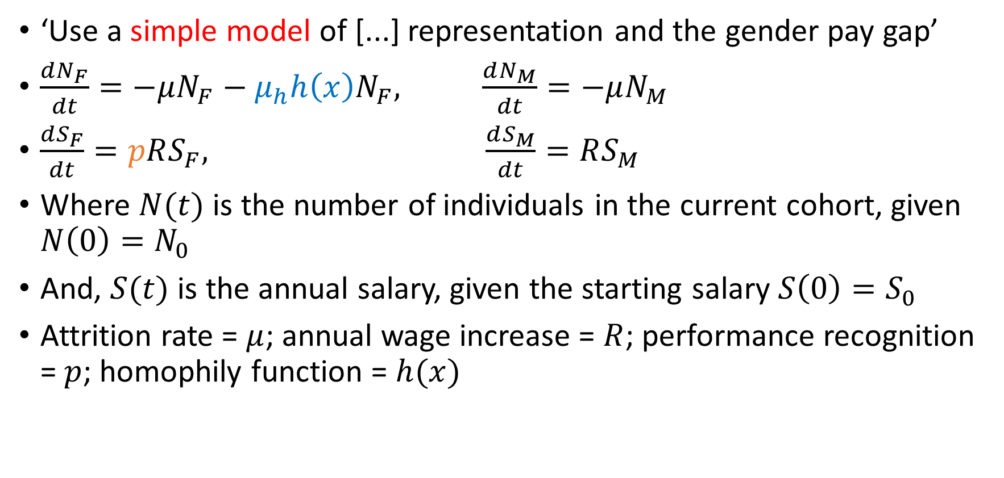
3. Mathematical models
‘Use a simple model of [...] representation and the gender pay gap’
$\frac{dN_{F}}{dt}=−μN_{F}−μ_{h}h\left(x\right)N_{F}, \frac{dN_{M}}{dt}=−μN_{M}$
$\frac{dS_{F}}{dt}=pRS_{F}, \frac{dS_{M}}{dt}=RS_{M}$
Where $N(t)$ is the number of individuals in the current cohort, given $N\left(0\right)=N_{0}$
And, $S(t)$ is the annual salary, given the starting salary $S\left(0\right)=S_{0}$
Attrition rate = $μ$; annual wage increase = $R$; performance recognition = $p$; homophily function = $h(x)$

Slide 21

3. Mathematical models
click here liam
$h\left(x\right)=\frac{1−\text{exp}(−λx)}{1+\text{exp}(−λx)}$, where $x=1−\frac{N_{F}}{N_{M}}$

Slide 22
3. Mathematical models
Model extensions
Data informed parameter values
Salary increase due to inflation; annual turn-over; initial salary informed by standardised pay scale
Ethnicity and/or intersectionality rather than/as well as gender bias
Gender and ethnicity effects interact non-linearly
The effect of salary difference on attrition using homophily function
NSF data predicts 50% of attrition difference due to lack of pay/promotion opportunities
The effect of performance recognition bias being affected by homophily
Decreased representation => increased pressure to be exceptional => higher internalised standards => higher quality publications => lower recognition

Slide 23
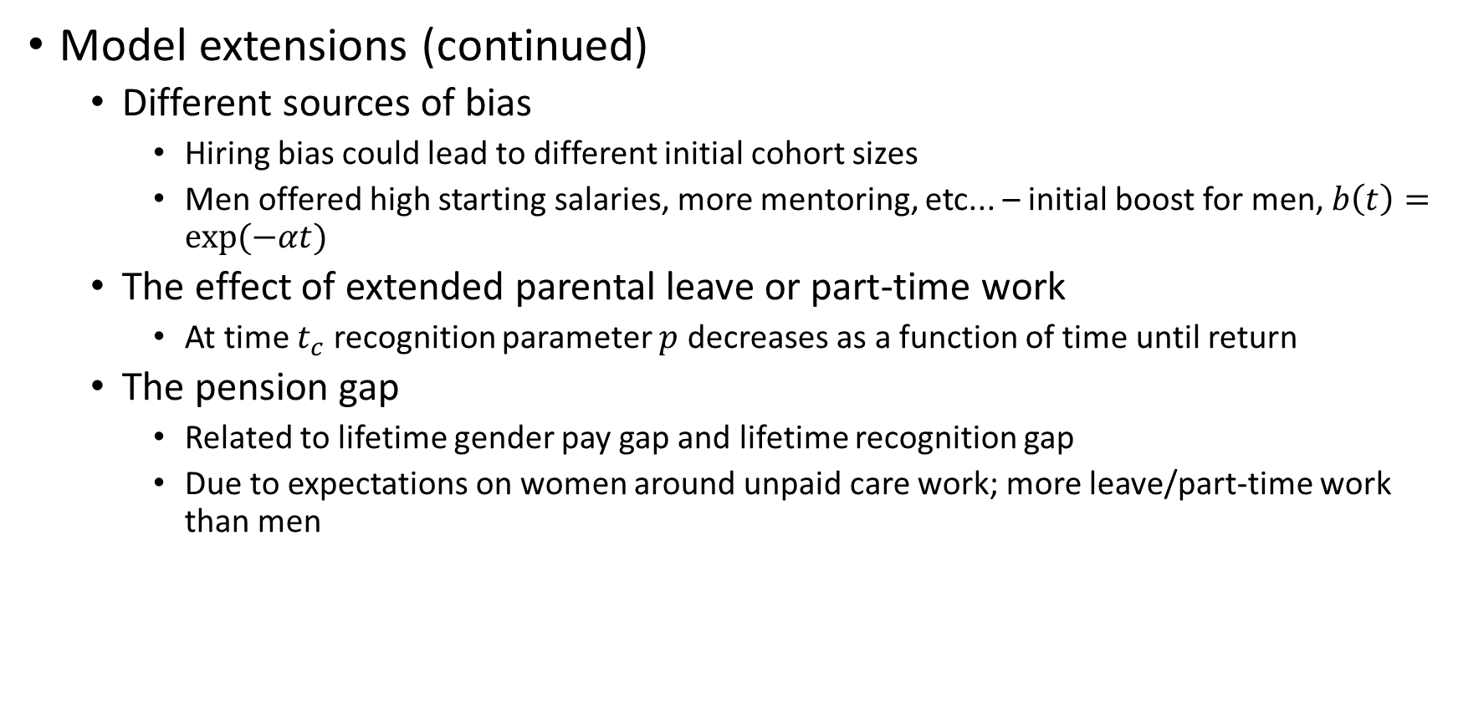
3. Mathematical models
Model extensions (continued)
Different sources of bias
Hiring bias could lead to different initial cohort sizes
Men offered high starting salaries, more mentoring, etc... – initial boost for men, $b\left(t\right)=\text{exp}(−αt)$
The effect of extended parental leave or part-time work
At time $t_{c}$ recognition parameter $p$ decreases as a function of time until return
The pension gap
Related to lifetime gender pay gap and lifetime recognition gap
Due to expectations on women around unpaid care work; more leave/part-time work than men

Slide 24
3. Mathematical models
Writing is important! (See LEARN)
NB: Doesn’t need to be academia!

Slide 25
4. Final note
Representation increases efficiency, democracy, and creativity
Mathematics is not immune (Pal Turan and his bricks)
Discrimination sucks EGGS ☹

